Slide 1

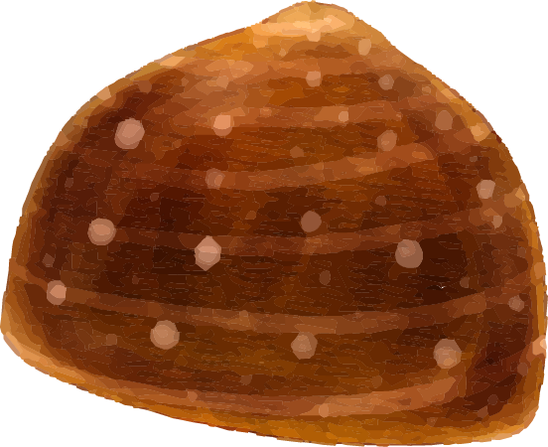



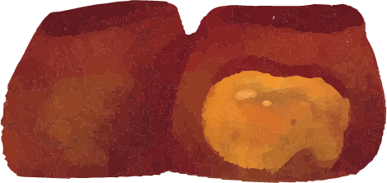
Chocolate Predictions
Team “Crunch ‘The Numbers’ Bar”
Kelsey Woods, Aayushi Verma, Manas Vani, & Chandani Thumar

Slide 2
Summarize Details of Dataset
Number of samples in test and train dataset
Total samples: 2130
70% Train
30% Test
Number of features
32 attributes
Target Feature
Rating
Random Forest Regression

Slide 3
Research Problem
Dataset of 2000+ chocolates and their characteristics
Aim is to predict which characteristics of chocolate contribute to higher ratings
This translates to higher customer satisfaction
Also need to create and train a machine learning model which can predict these ratings

Slide 4
Project Plan
Cleaning
Python
Machine Learning
Weka & Python
EDA
Python
Visualization
Python

Slide 5
Data Cleaning
Data cleaning methods:
Drop NA & null
Label encoding
Convert object to float64 and int64
Replace null with mean of column
Tools:
Python
pandas

Slide 6
Exploratory Data Analysis (EDA)
Exploratory Data Analysis is a technique to understand the data before fitting that into a model. Read the CSV file of data by using Pandas library and perform a few lines of code to visualize the columns and rows.
The count of number_of_ingredient gave the average number of ingredients used in chocolate. Visualization of the target variable (rating) is done by mean of that to get the average and the highest rating of that chocolate bar.
Describe method performs mathematical ideas for each and every column. That also helps in Outliers by looking at min and max of a particular column.
For better judgment, plotting all variables vs target variables(rating). It explains which variable is highly correlated with the target variable.
The graphical representation tool for correlation is Heat map that uses a system of color-coding to represent the different variables.

Slide 7
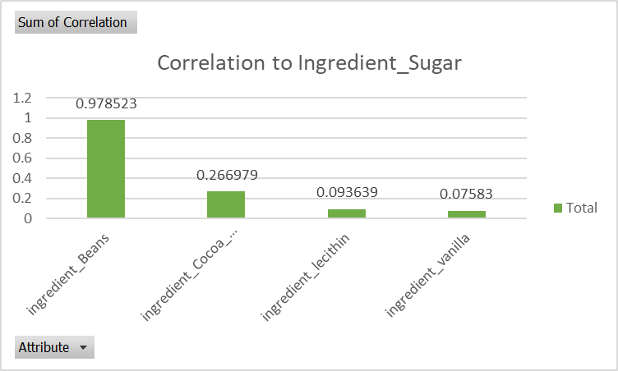
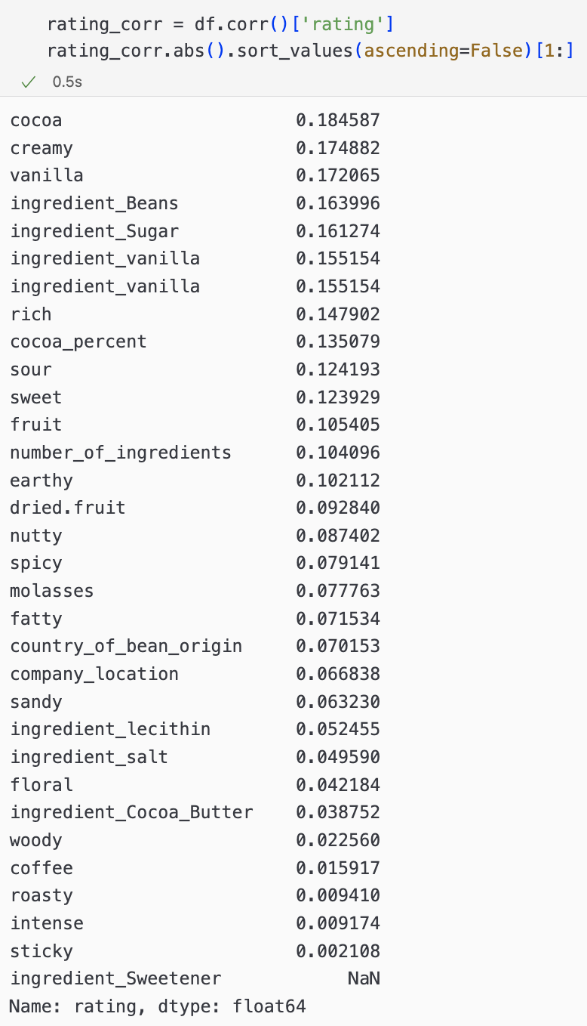
EDA Visualization

Slide 8
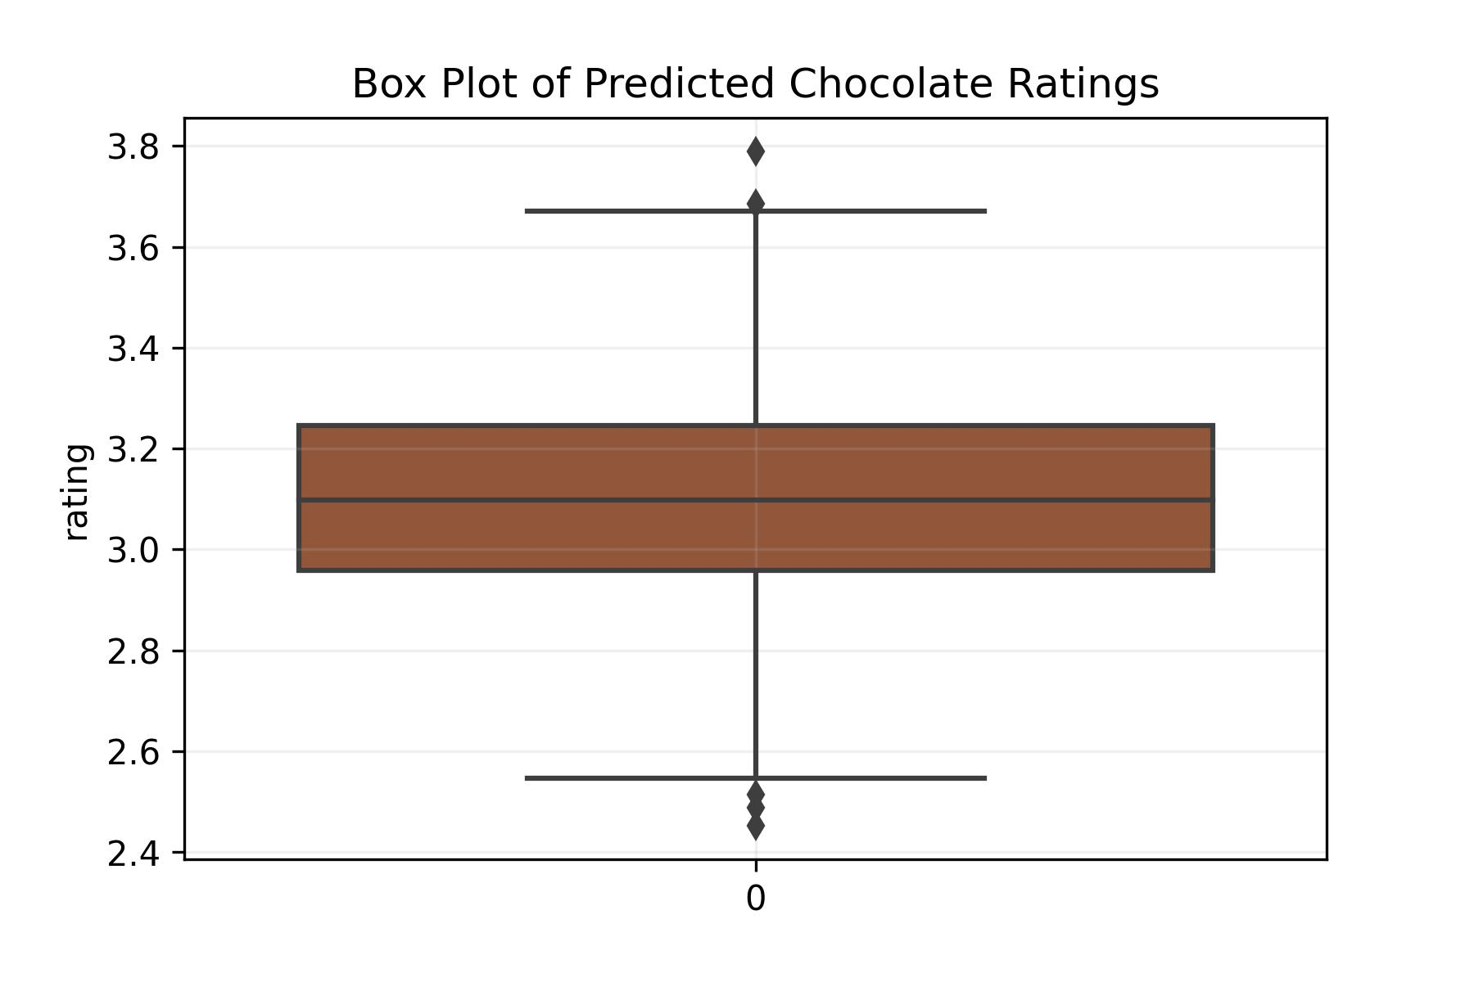
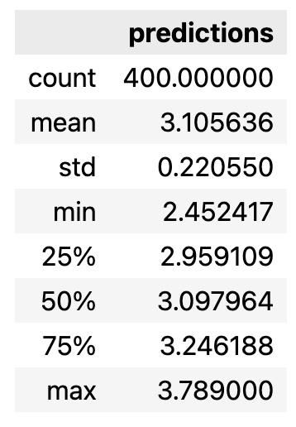
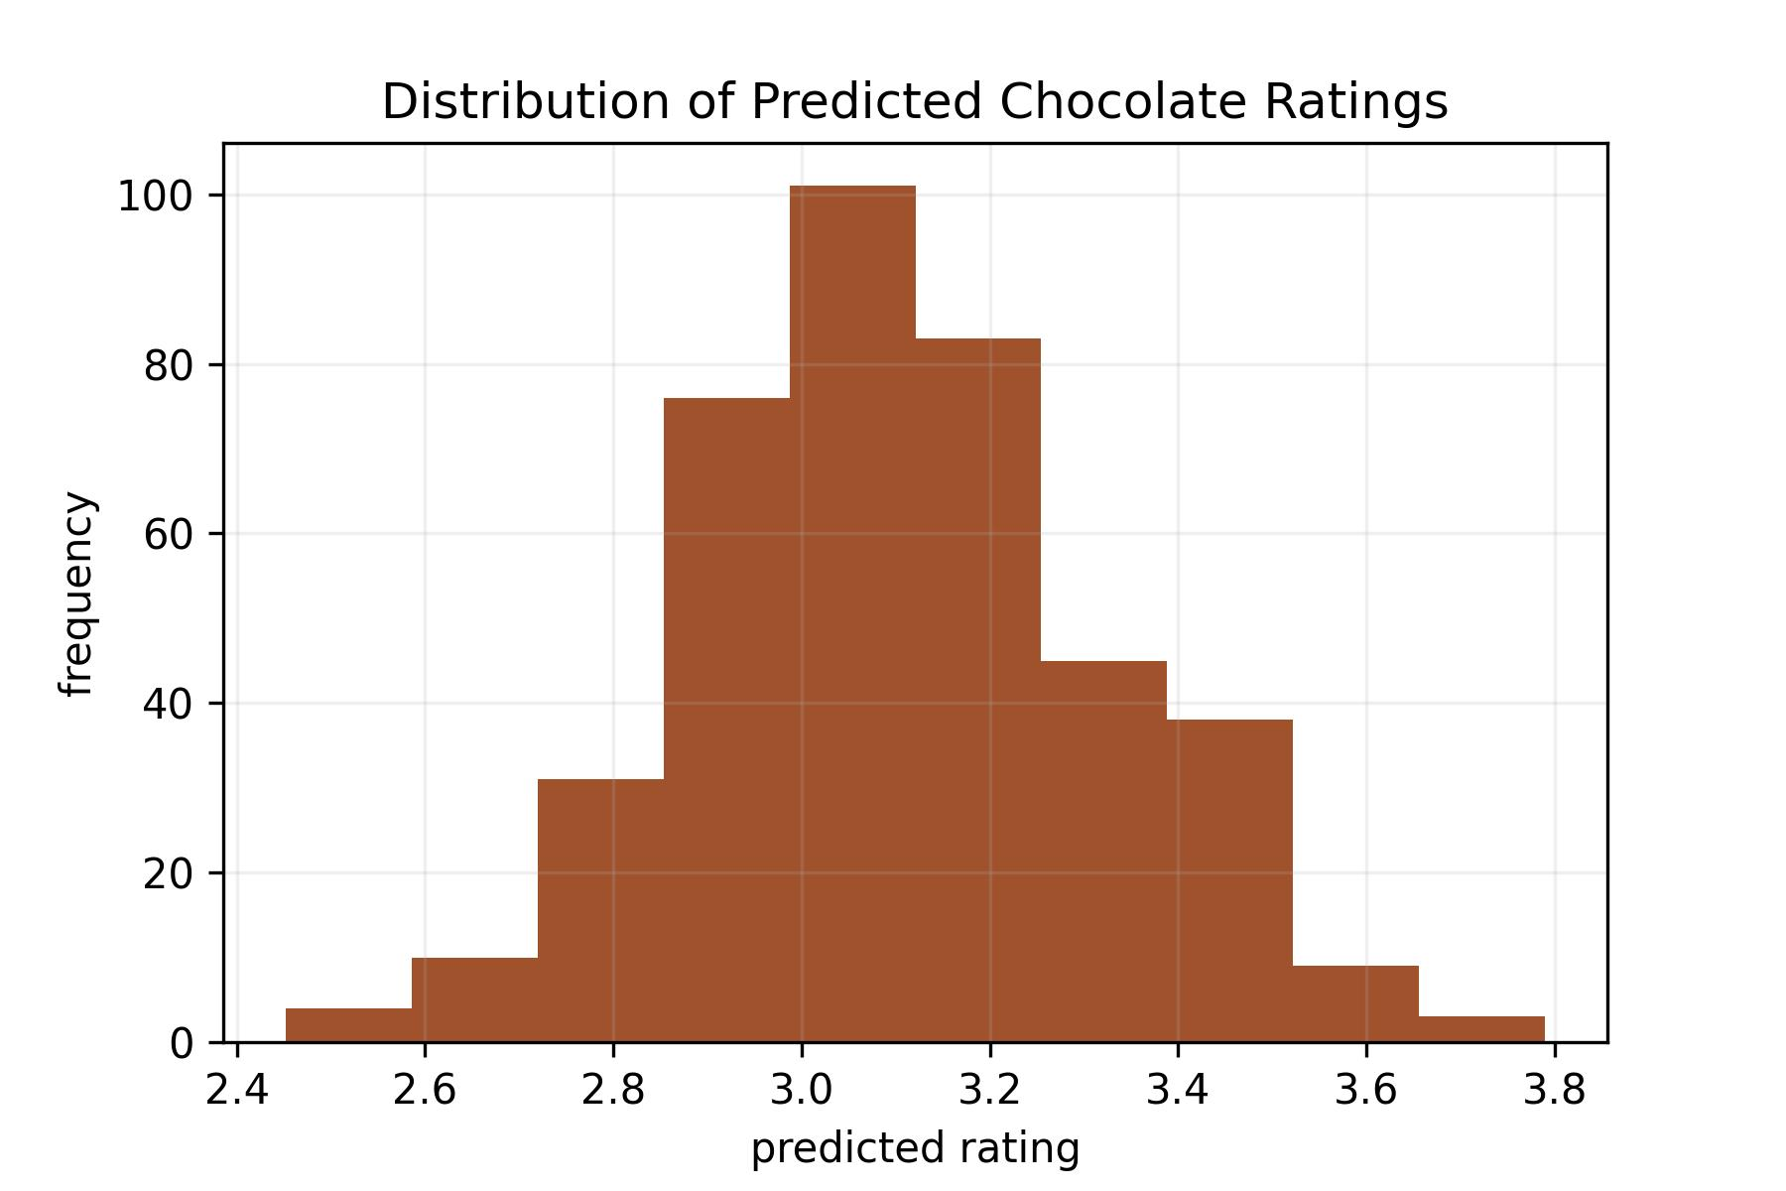
Prediction of Chocolate Rating
Used Random Forest Regression model to train data using scikit-learn
Obtained set of 400 predicted ratings
Model accuracy 86.67%, MAE 0.41, RMSE - 0.51188

Slide 9
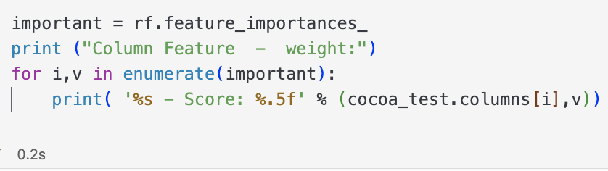
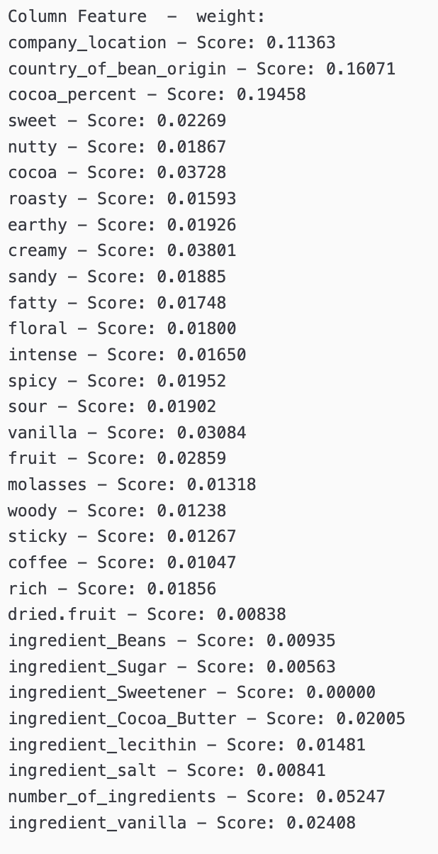
Features & Weight
We used the .feature_importances_ function to extract the features the Random Forest Model understands to be important
The most important features according to the model were - 1) Cocoa_percent (19.45%), Country_of_bean_origin (16.071%), Company_location (11.36%), Number of Ingredients (5.24%)

Slide 10
Conclusion
Random forest regression model gave better preliminary results than other models
Further analysis can include side-by-side comparison of different models

